Slide 1
Dimensionality Reduction
Dr. Samir Rustamov
Some slides taken from Andrew Ng’s Machine Learning course https://www.coursera.org/learn/machine-learning

Slide 2
2019 World Happiness Report (United Nations Sustainable Development Solutions Network)
Overall rank | Country or region | Score | GDP per capita | Social support | Healthy life expectancy | Freedom to make life choices | Generosity | Perceptions of corruption
1 | Finland | 7.769 | 1.340 | 1.587 | 0.986 | 0.596 | 0.153 | 0.393
2 | Denmark | 7.600 | 1.383 | 1.573 | 0.996 | 0.592 | 0.252 | 0.410
3 | Norway | 7.554 | 1.488 | 1.582 | 1.028 | 0.603 | 0.271 | 0.341
4 | Iceland | 7.494 | 1.380 | 1.624 | 1.026 | 0.591 | 0.354 | 0.118
5 | Netherlands | 7.488 | 1.396 | 1.522 | 0.999 | 0.557 | 0.322 | 0.298
6 | Switzerland | 7.480 | 1.452 | 1.526 | 1.052 | 0.572 | 0.263 | 0.343
7 | Sweden | 7.343 | 1.387 | 1.487 | 1.009 | 0.574 | 0.267 | 0.373
8 | New Zealand | 7.307 | 1.303 | 1.557 | 1.026 | 0.585 | 0.330 | 0.380
9 | Canada | 7.278 | 1.365 | 1.505 | 1.039 | 0.584 | 0.285 | 0.308
10 | Austria | 7.246 | 1.376 | 1.475 | 1.016 | 0.532 | 0.244 | 0.226
11 | Australia | 7.228 | 1.372 | 1.548 | 1.036 | 0.557 | 0.332 | 0.290
12 | Costa Rica | 7.167 | 1.034 | 1.441 | 0.963 | 0.558 | 0.144 | 0.093
13 | Israel | 7.139 | 1.276 | 1.455 | 1.029 | 0.371 | 0.261 | 0.082
https://en.wikipedia.org/wiki/World_Happiness_Report

Slide 3
Data Visualization
How can we visualize data which has more than 3 features?
Is there a representation better than the coordinate axes?
Is it really necessary to show all the 6 dimensions?
What if there are strong correlations between the features?
How could we find the smallest subspace of the 6-D space that keeps the most information about the original data?
A solution: Principal Component Analysis!

Slide 4



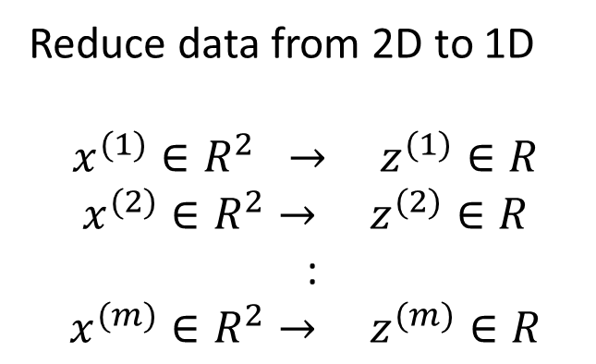

Principal Component Analysis (PCA) problem formulation
Reduce from 2-dimension to 1-dimension: Find a direction (a vector $u^{(1)}∈R^{n}$) onto which to project the data so as to minimize the projection error.
$$u^{(1)}$$
Reduce data from 2D to 1D
$$x^{(1)}∈R^{2} → z^{(1)}∈R$$
$$x^{(2)}∈R^{2}→ z^{(2)}∈R$$
:
$$x^{(m)}∈R^{2}→ z^{(m)}∈R$$
Andrew Ng
Notes:
Add more unique colors (3-4)

Slide 5
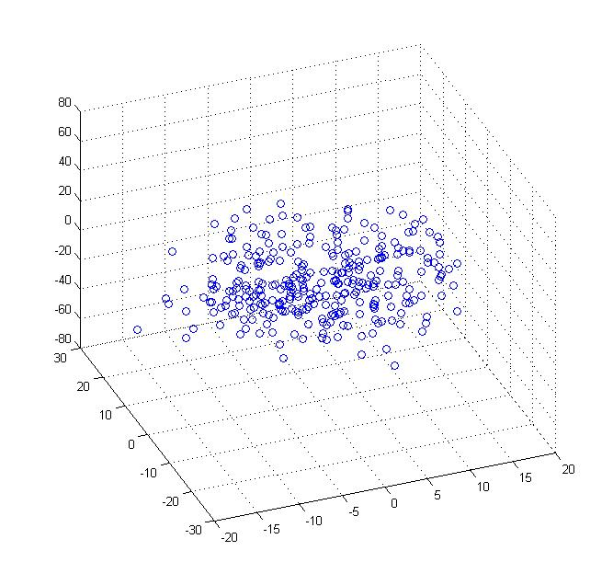
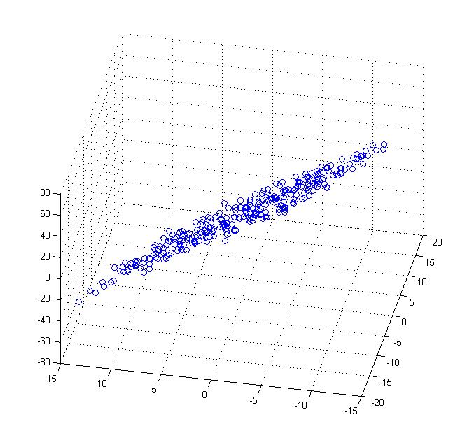

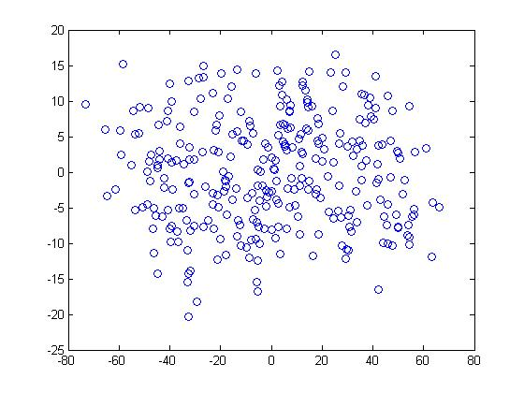




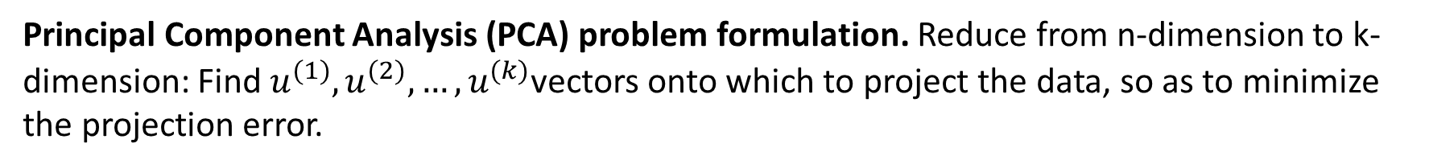
Reduce data from 3D to 2D
Reduce from 3-dimension to 2-dimension: Find a direction (a vector ( $u^{(1)},u^{(2)})∈R^{n}$) onto which to project the data so as to minimize the projection error.
$$u^{(1)}$$
$$u^{(2)}$$
Principal Component Analysis (PCA) problem formulation. Reduce from n-dimension to k-dimension: Find $u^{(1)},u^{(2)},…,u^{(k)}$vectors onto which to project the data, so as to minimize the projection error.
Andrew Ng
Notes:
Pca3d2d in lecture-slides/assets/pca/
Label axes

Slide 6
PCA is not linear regression
Fitting a line: vertical vs. perpendicular error
Linear regression
PCA

Slide 7
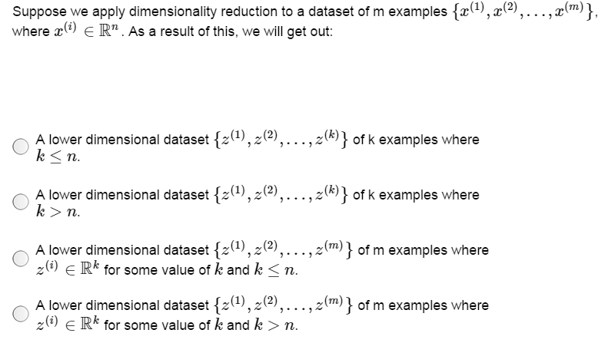

Slide 8
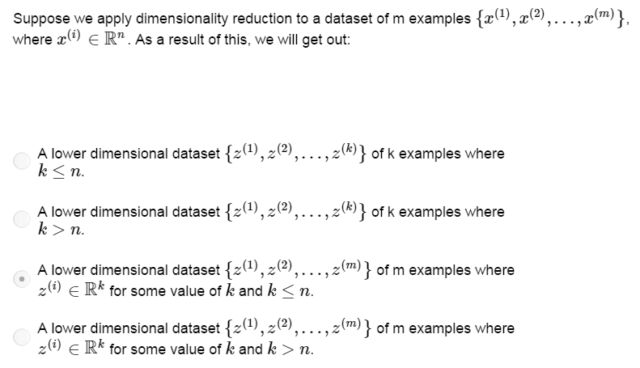

Slide 9
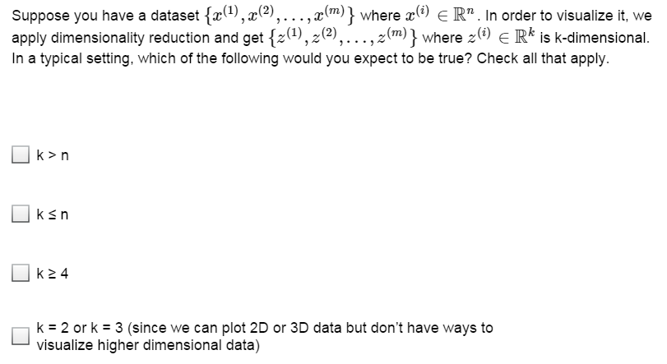

Slide 10
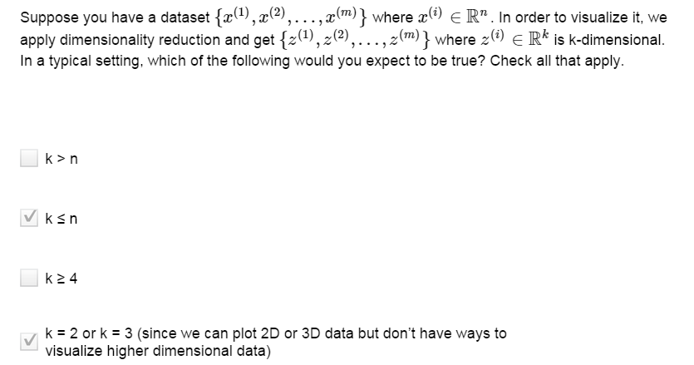

Slide 11
Principal Component Analysis
Idea. Given data points in a n-dimensional space, project into lower dimensional space while preserving as much information as possible
Orthogonal projection of data onto lower-dimension linear space that...
maximizes variance of projected data (purple line)
minimizes mean squared distance between data points and their projections (the blue segments)
© Ron Shamir

Slide 12

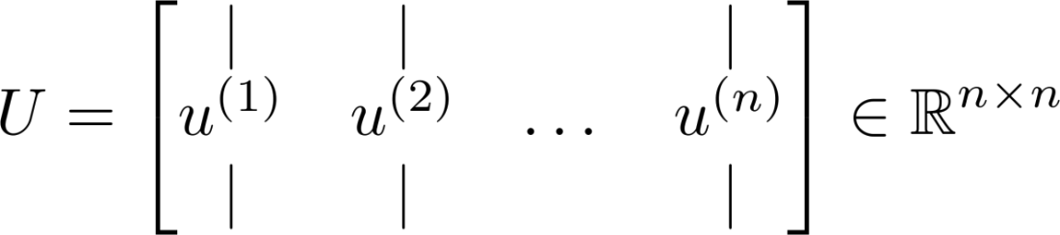
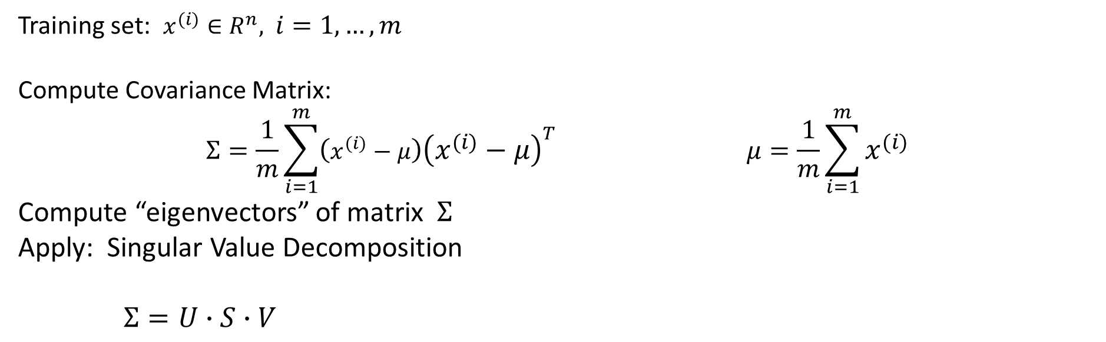

Principal Component Analysis algorithm
Training set: $x^{(i)}∈R^{n},$ $i=1,…,m$
Compute Covariance Matrix: $$Σ=\frac{1}{m}\sum_{i=1}^{m}{\left(x^{(i)}−μ\right){\left(x^{(i)}−μ\right)}^{T}} μ=\frac{1}{m}\sum_{i=1}^{m}{x^{(i)}}$$
Compute “eigenvectors” of matrix $Σ$
Apply: Singular Value Decomposition
$Σ=U∙S∙V$
U, s, V = np.linalg.svd(Sigma)
https://towardsdatascience.com/singular-value-decomposition-example-in-python-dab2507d85a0
$$k$$
Ureduce = U[:,1:k]

Slide 13
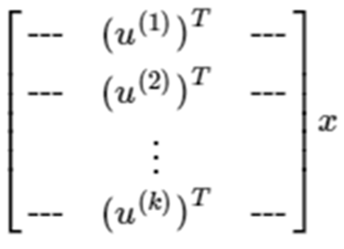
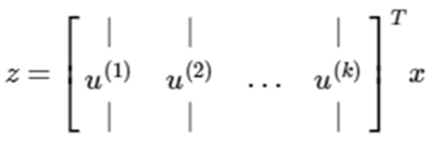

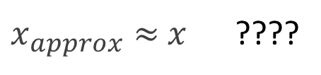
Principal Component Analysis (PCA) algorithm
In PCA, we obtain$z∈R^{k}$ from $x∈R^{n}$ as follows: $z=U_{reduce}^{T}∙x$
z = [k x 1]
[n x k]
[n x 1]
[k x n]
[n x 1]
Reconstruction from compressed representation: $x_{approx}=U_{reduce}∙z$
[n x 1]
[n x k]
[k x 1]
$x_{approx}≈$ $x$ ????

Slide 14
Choosing the number of principal components

Slide 15

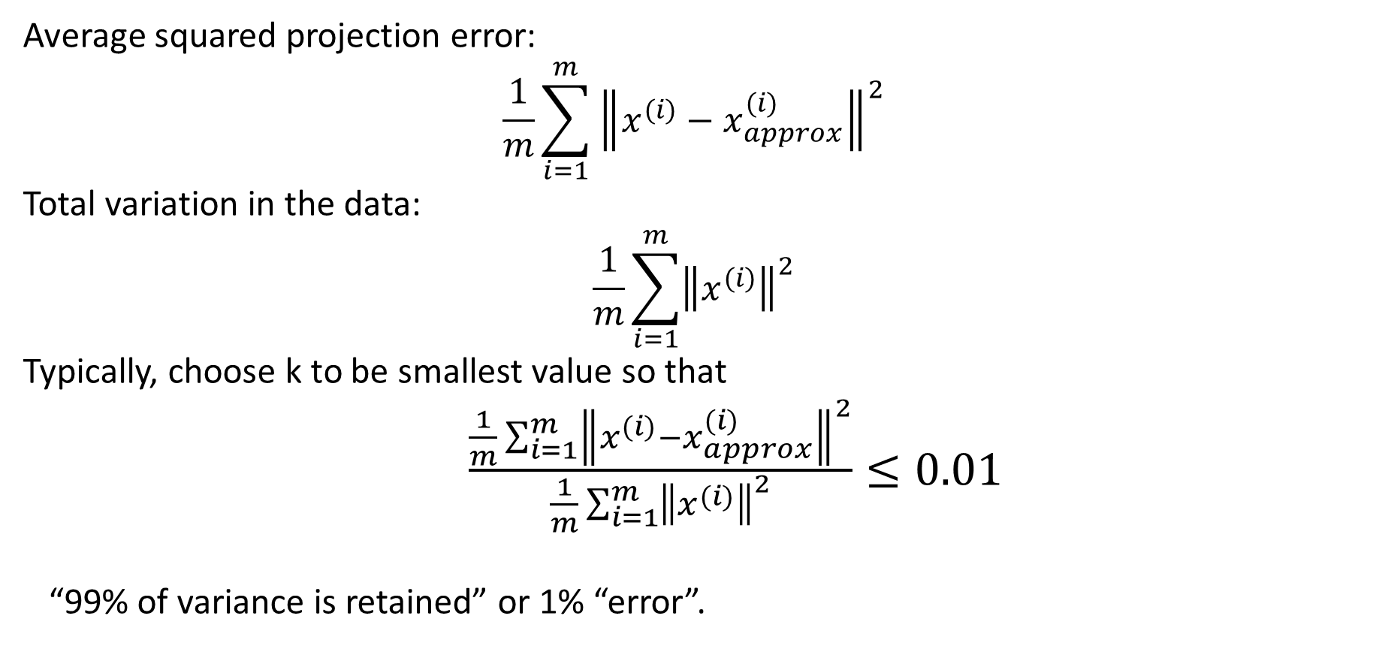
Choosing (number of principal components)
Average squared projection error:
$$\frac{1}{m}\sum_{i=1}^{m}{{\left\|x^{(i)}−x_{approx}^{(i)}\right\|}^{2}}$$
Total variation in the data:
$$\frac{1}{m}\sum_{i=1}^{m}{{\left\|x^{(i)}\right\|}^{2}}$$
Typically, choose k to be smallest value so that
$\frac{\frac{1}{m}\sum_{i=1}^{m}{{\left\|x^{(i)}−x_{approx}^{(i)}\right\|}^{2}}}{\frac{1}{m}\sum_{i=1}^{m}{{\left\|x^{(i)}\right\|}^{2}}}≤0.01$
“99% of variance is retained” or 1% “error”.
Andrew Ng

Slide 16


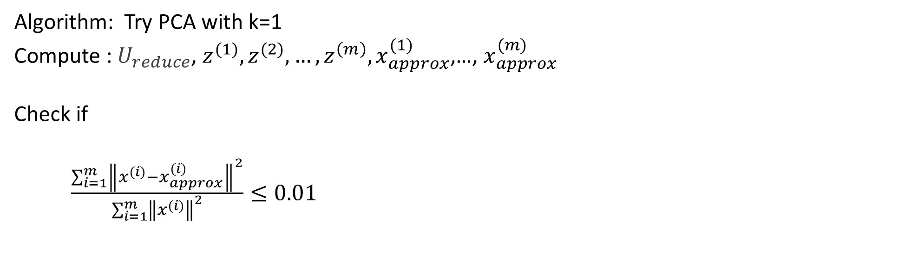
Choosing (number of principal components)
Algorithm: Try PCA with k=1
Compute : $U_{reduce}$, $z^{(1)},z^{(2)}, …,z^{\left(m\right)}, x_{approx}^{(1)}$,…, $x_{approx}^{(m)}$
Check if
$\frac{\sum_{i=1}^{m}{{\left\|x^{(i)}−x_{approx}^{(i)}\right\|}^{2}}}{\sum_{i=1}^{m}{{\left\|x^{(i)}\right\|}^{2}}}≤0.01$
$Σ=U∙S∙V$
Pick smallest value of k for which
$\frac{\sum_{i=1}^{k}{S_{ii}}}{\sum_{i=1}^{m}{S_{ii}}}≥0.99$
(99% of variance retained)
If not, check for k=2,3….
Andrew Ng

Slide 17
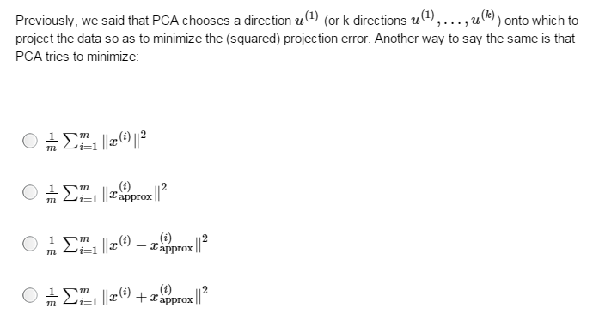

Slide 18
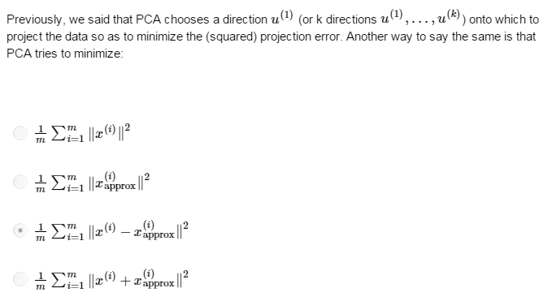

Slide 19
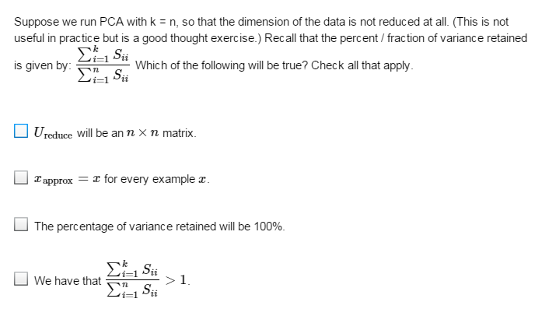

Slide 20
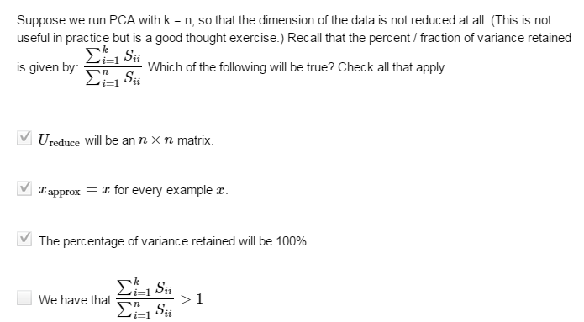

Slide 21
Advice for applying PCA

Slide 22
Application of PCA
Compression
Reduce memory/disk needed to store data
Speed up learning algorithm
Visualization

Slide 23
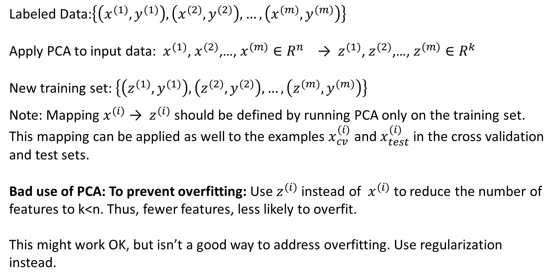
Supervised learning speedup
Labeled Data:$\left\{\left(x^{(1)},y^{(1)}\right),\left(x^{(2)},y^{(2)}\right),…,\left(x^{(m)},y^{(m)}\right)\right\}$
Apply PCA to input data: $x^{(1)}$, $x^{(2)}$,…, $x^{(m)}∈R^{n}$ → $z^{(1)}$, $z^{(2)}$,…, $z^{(m)}∈R^{k}$
New training set: $\left\{\left(z^{(1)},y^{(1)}\right),\left(z^{(2)},y^{(2)}\right),…,\left(z^{(m)},y^{(m)}\right)\right\}$
Note: Mapping $x^{(i)}$ → $z^{(i)}$ should be defined by running PCA only on the training set. This mapping can be applied as well to the examples $x_{cv}^{(i)}$ and $x_{test}^{(i)}$ in the cross validation and test sets.
Bad use of PCA: To prevent overfitting: Use $z^{(i)}$ instead of $x^{(i)}$to reduce the number of features to k<n. Thus, fewer features, less likely to overfit.
This might work OK, but isn’t a good way to address overfitting. Use regularization instead.
Andrew Ng

Slide 24
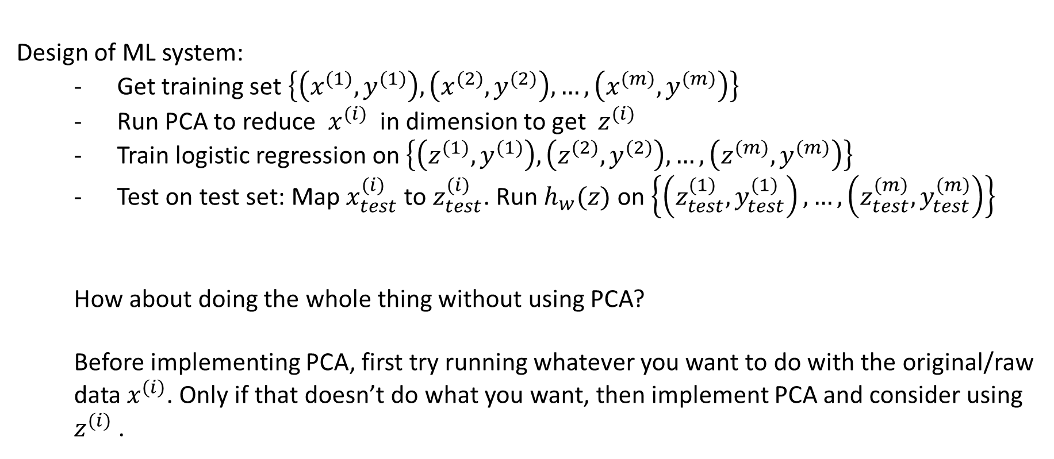
PCA is sometimes used where it shouldn’t be
Design of ML system:
Get training set $\left\{\left(x^{(1)},y^{(1)}\right),\left(x^{(2)},y^{(2)}\right),…,\left(x^{(m)},y^{(m)}\right)\right\}$
Run PCA to reduce $x^{(i)}$ in dimension to get $z^{(i)}$
Train logistic regression on $\left\{\left(z^{(1)},y^{(1)}\right),\left(z^{(2)},y^{(2)}\right),…,\left(z^{(m)},y^{(m)}\right)\right\}$
Test on test set: Map $x_{test}^{(i)}$ to $z_{test}^{(i)}$. Run $h_{w}(z)$ on $\left\{\left(z_{test}^{(1)},y_{test}^{(1)}\right), …,\left(z_{test}^{(m)},y_{test}^{(m)}\right)\right\}$
How about doing the whole thing without using PCA?
Before implementing PCA, first try running whatever you want to do with the original/raw data $x^{(i)}$. Only if that doesn’t do what you want, then implement PCA and consider using $z^{(i)}$ .
Andrew Ng

Slide 25
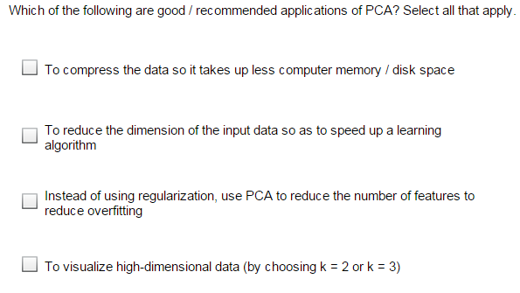

Slide 26
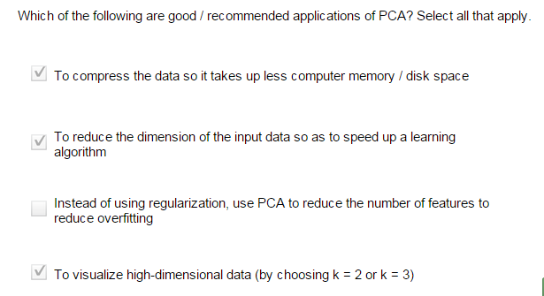

Slide 27
Reading Materials
Principal components analysis. Andrew Ng http://cs229.stanford.edu/notes2019fall/cs229-notes10.pdf

